Slide 1
Week Twelve
Don Quixote

Slide 2
Tuesday, Nov. 10
Objectives:
Analyze the use of language to develop satirical tone.
Identify themes and motifs in literature.
Essential Question:
How does Cervantes satirize medieval romances and chivalrous ideals to develop a theme in Don Quixote?
Warm-up: What’s the difference between being a fan and being obsessed? Think of people, things, or events that tend to attract fans. When do you think enthusiasm crosses the line into obsession?
Friends episode, Joey’s Obsessed Fan

Slide 3
Look at the following pictures. What common ideals do they seem to suggest about the following concepts?
Expectations for the ideal man
The role and image of women
Love
Bravery

Slide 4
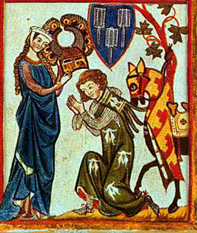
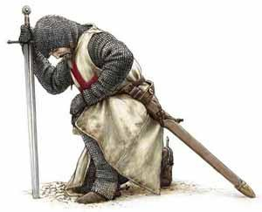
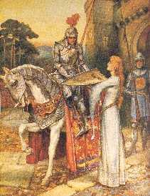
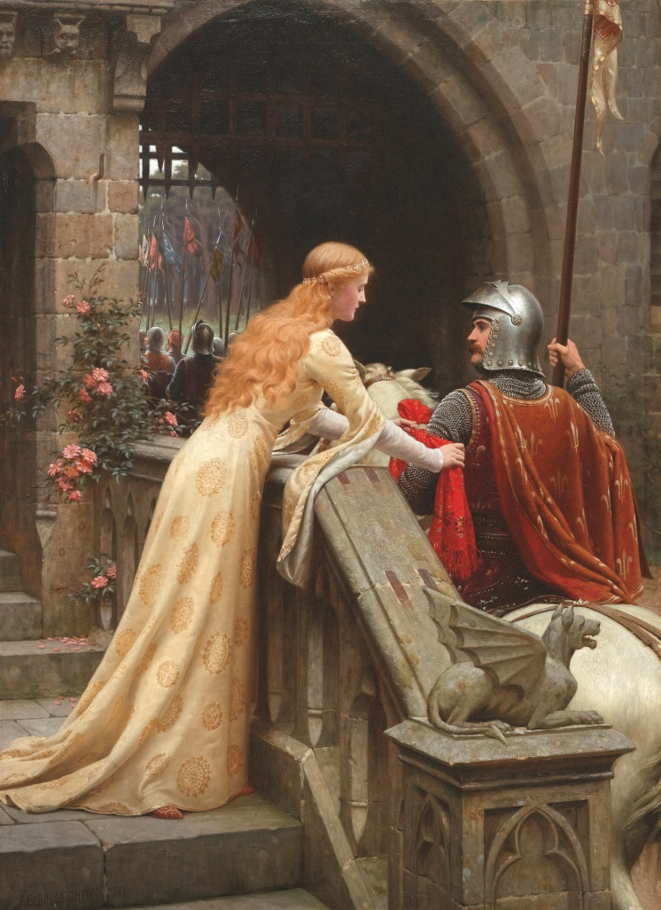
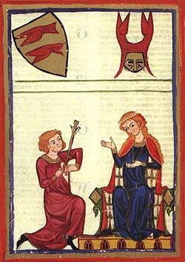

Slide 5
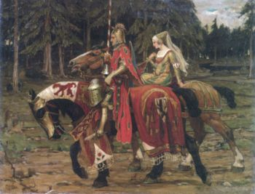
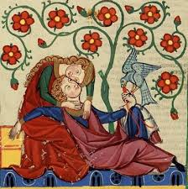
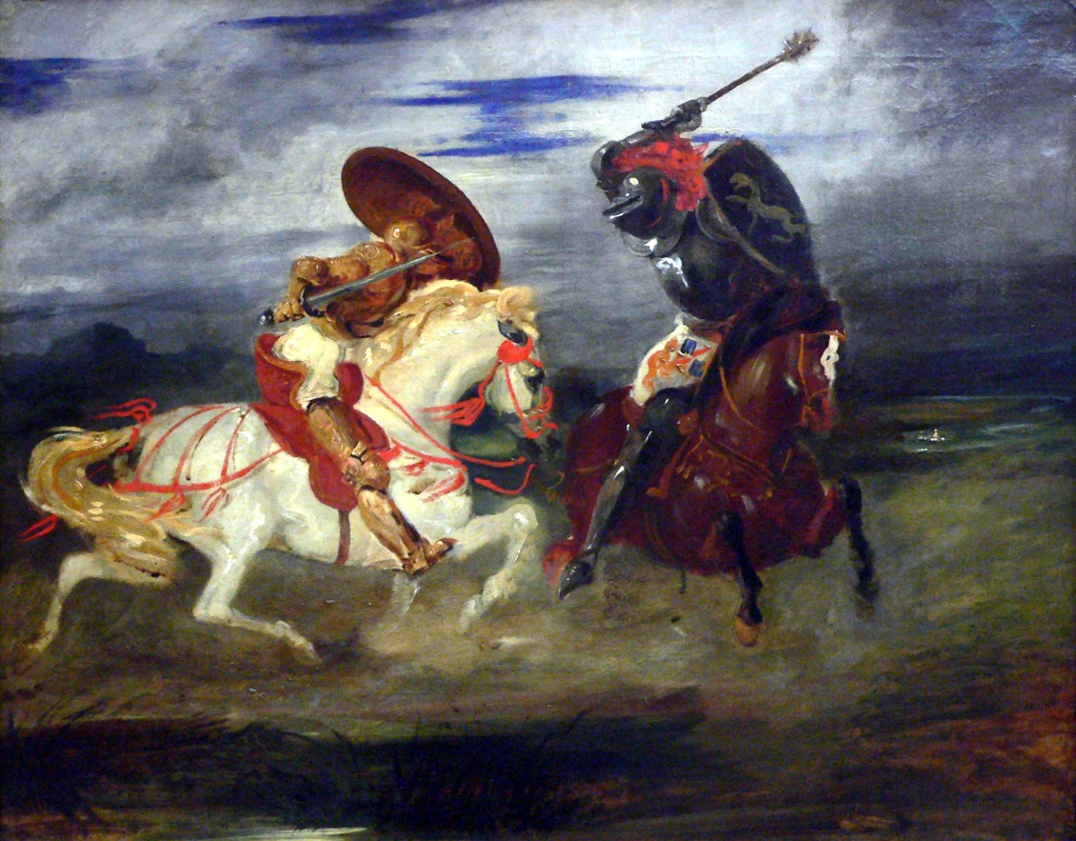
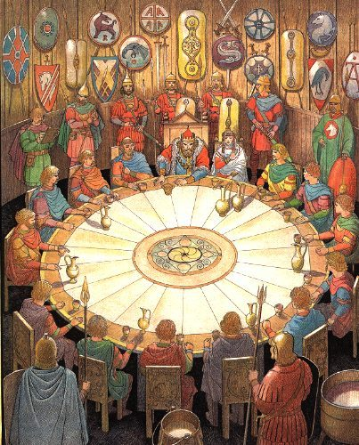

Slide 6
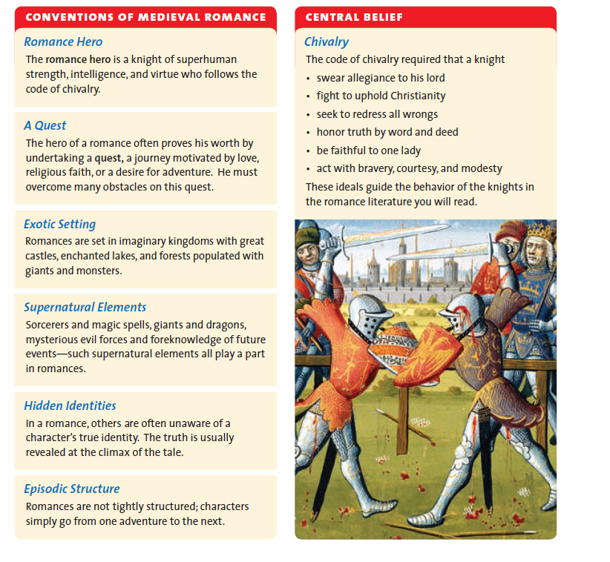
Conventions of Medieval Romance and Chivalry

Slide 7
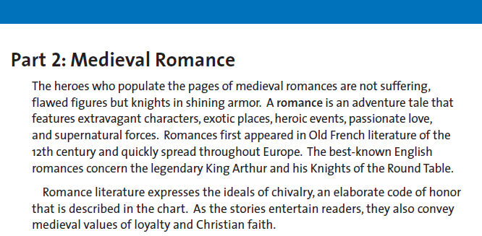
Medieval Romance: Legends of Knights
Using the following slides with the conventions of romance and the excerpt from Sir Gawain and the Green Knight, identify the characteristics of the ideal knight.

Slide 8
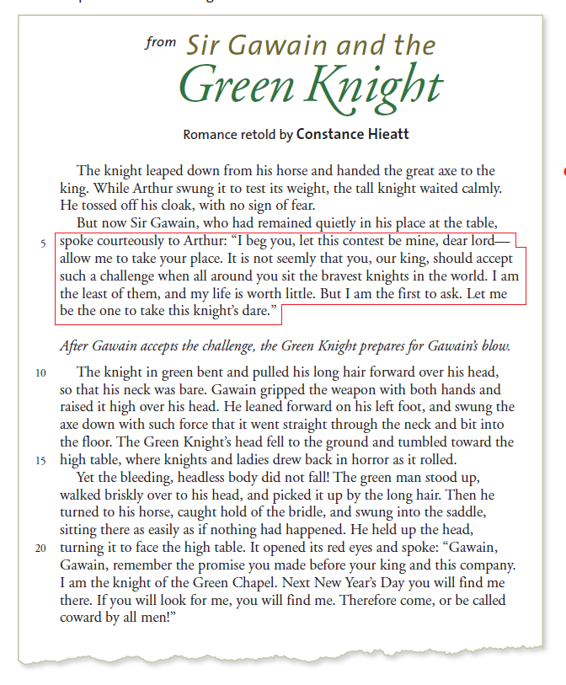

Slide 9
Miguel de Cervantes
Background information in your handout

Slide 10
Thursday, Nov. 12
Objectives:
Analyze the use of language to develop satirical tone.
Identify themes and motifs in literature.
Essential Question:
How does Cervantes satirize medieval romances and chivalrous ideals to develop a theme in Don Quixote?
Warm-up: Vocabulary, Unit 4 “Choosing the Right Word”
FINAL Novel Study 2-column journals due
Keep out on desk for me to grade!

Slide 11
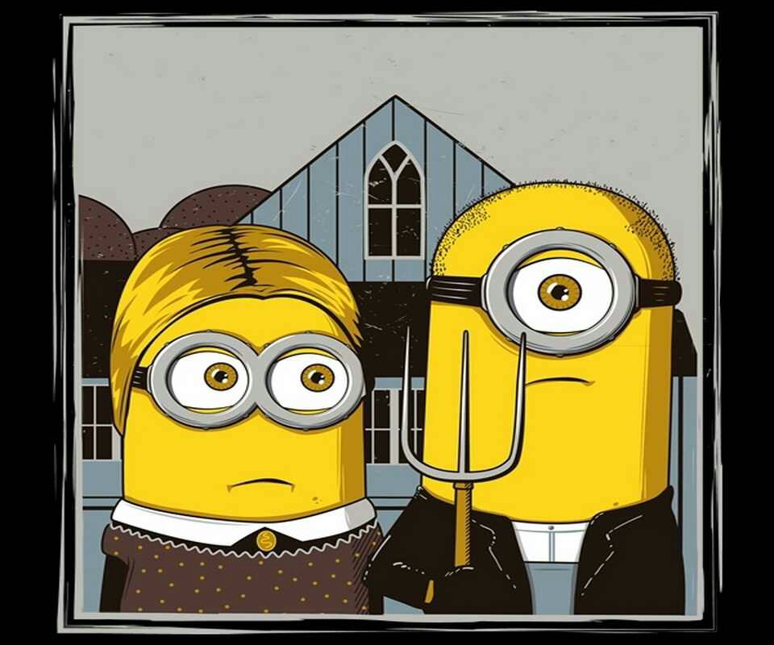
Parody Brainstorm
What is parody?
What are the elements of parody?
How is the following video an example of parody?

Slide 12
The text parodies the Medieval literature that embodies the ideas of courtly love, knighthood, chivalry.
Create a chart on notebook paper that identifies quotes that help to develop the parody.
Quote (cite correctly) | Analysis of the parody

Slide 13
Chapter 1
The dangers of reading
The crazy fan
Parody of heroic adventure
Chapter 2
Continuation of the crazy fan
Parody of heroic adventure
Chapter 7
Character foils
“I Don Quixote”
Chapter 8
Tacky parody
Character foils
Reality vs. fantasy
“tilting at windmills”

Slide 14
The Impossible Dream
The story of Don Quixote has, for many, become something beyond satire or parody. It seems to represent a man pursuing a dead, romantic ideal, and there is something beautiful in it. Even if Quixote is a ridiculous figure, he is on a noble quest to defeat wrong and to hold up precious ideals in a world that has become crass and practical, like poor Sancho on his burro.
The Broadway musical Man of La Mancha adapts the tale of Don Quixote and, though it is still clear that the old man is off his rocker, the beauty of his quest, the hopeless cause, is captured in the song “The Impossible Dream.”
https://www.youtube.com/watch?v=LgzXwpePTTU
Vocabulary:
Quixotic: extravagantly chivalrous or romantic; visionary, impractical, or impracticable.
Tilt at windmills: to fight battles with imaginary enemies; to fight against unimportant enemies or issues

Slide 15
Create a new adventure for Don Quixote that parodies a concept of medieval literature or poetry.
It must be in dialogue form between Don Quixote and either Sancho Panza or Dulcinea del Toboso .
It can deal with love, chivalry, adventure, bravery, etc.

